Slide 1


Monitoring Azure AD MFA Activity
Azure Active Directory (Azure AD) Multi-Factor Authentication (MFA) is a powerful security feature that adds an extra layer of protection to user accounts by requiring additional verification during the login process. Effectively monitoring Azure AD MFA activity is crucial for maintaining the security and integrity of your organization's data and resources. This presentation will guide you through the key aspects of monitoring Azure AD MFA, from understanding activity data to generating custom reports and integrating with security tools.

Slide 2

Understanding MFA Activity Data
Sign-In Events
Enforcement Policies
Azure AD MFA generates detailed sign-in event logs that capture information about each authentication attempt, including the user, location, and the method of verification used (e.g., push notification, SMS, phone call).
Azure AD MFA activity logs include information about the enforcement of MFA policies, such as which users and applications are subject to MFA requirements and the conditions under which MFA is triggered.
1
2
3
Registration and Enrollment
The system also tracks when users register for and enroll in Azure AD MFA, providing insights into the adoption and usage of the security feature across your organization.

Slide 3
Accessing MFA Activity Reports
Azure Portal
Microsoft Graph API
Azure Monitor
Azure AD administrators can access MFA activity reports directly in the Azure Portal, which provides a user-friendly interface for viewing and filtering the data.
For more advanced reporting and integration with external systems, you can leverage the Microsoft Graph API to programmatically retrieve and analyze MFA activity data.
Azure Monitor allows you to collect, analyze, and act on telemetry data, including Azure AD MFA activity, to gain deeper insights and set up custom alerts.

Slide 4
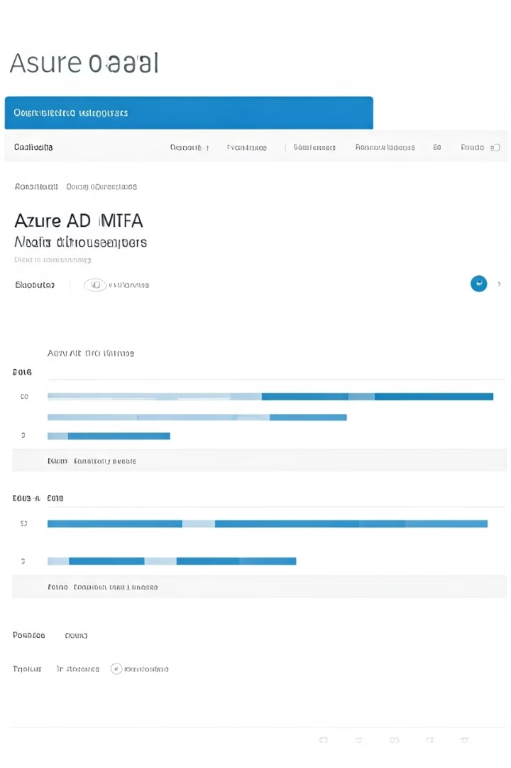
Analyzing MFA Usage Patterns
1
Successful vs. Failed Attempts
Analyze the ratio of successful to failed MFA attempts to identify potential security issues or user experience problems.
2
Verification Methods Used
Understand which MFA verification methods (e.g., push notification, SMS, phone call) are most commonly used, as this can inform your MFA policies and user education efforts.
3
Temporal Patterns
Identify any patterns or spikes in MFA activity over time, which may reveal seasonal trends or suspicious behavior that requires further investigation.
4
Geographic Distribution
Examine the geographic distribution of MFA activity to detect any unusual login patterns that could indicate potential security risks.

Slide 5
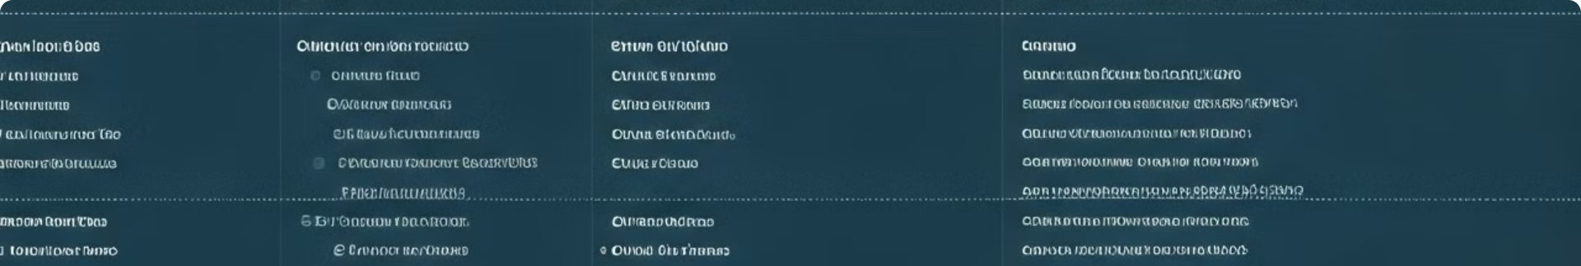
Identifying High-Risk MFA Events
Multiple Failed Attempts
Unusual Verification Methods
Monitor for multiple failed MFA attempts, as this could indicate an unauthorized user trying to gain access to the system.
Be alert for the use of uncommon or unexpected MFA verification methods, as this may suggest a security breach or compromised user account.
Locations and Devices
Conditional Access Policies
Analyze the locations and devices associated with MFA events, looking for anything out of the ordinary that could indicate a security threat.
Ensure that your Conditional Access policies are working as expected and effectively mitigating risks identified through MFA activity monitoring.

Slide 6
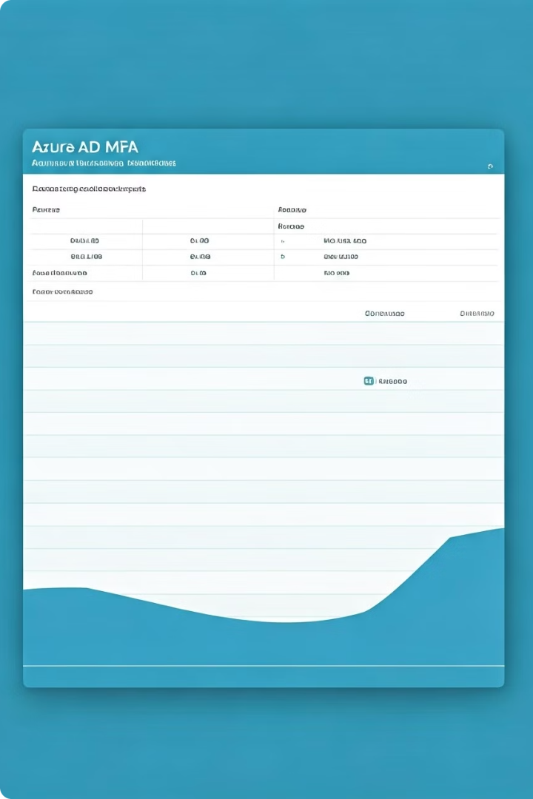



Investigating MFA Authentication Failures
Identify Failures
Analyze MFA activity logs to identify any failed authentication attempts, including the users, locations, and verification methods involved.
Determine Causes
Investigate the underlying reasons for the authentication failures, such as user errors, technical issues, or potential security breaches.
Implement Remediation
Based on the investigation, take appropriate actions to address the root causes of the MFA authentication failures, such as user training, policy adjustments, or security enhancements.

Slide 7
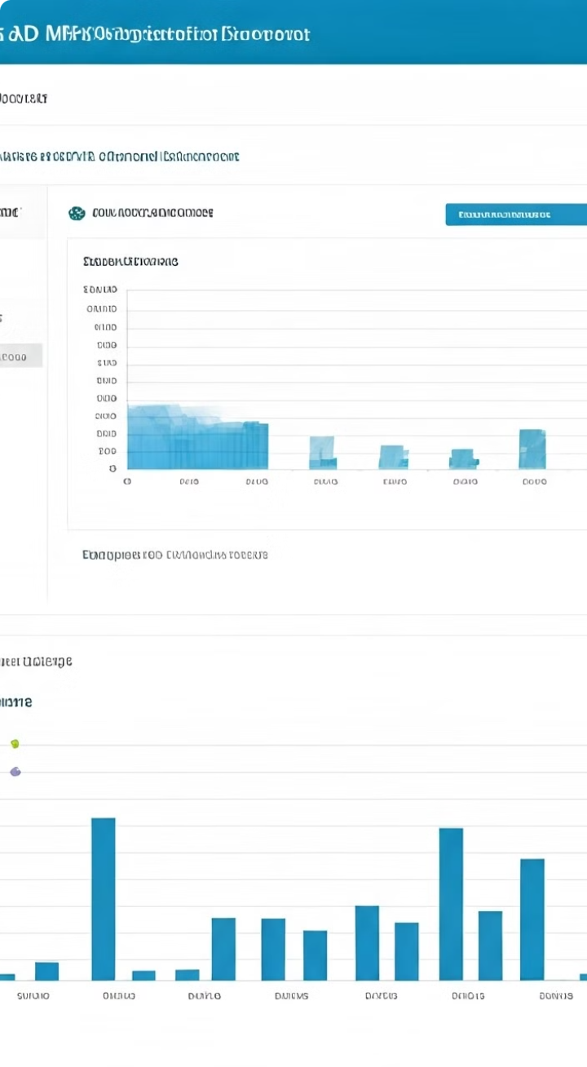




Monitoring MFA Registration and Enforcement
User Registration
Track user enrollment and registration for Azure AD MFA to ensure full adoption and compliance across your organization.
Policy Enforcement
Monitor the enforcement of your Azure AD MFA policies, including which users and applications are subject to MFA requirements.
Alerts and Notifications
Set up custom alerts and notifications to proactively monitor for any changes or issues related to MFA registration and enforcement.
Reporting and Analytics
Leverage comprehensive reporting and analytics to gain deeper insights into the overall MFA adoption and usage within your organization.

Slide 8
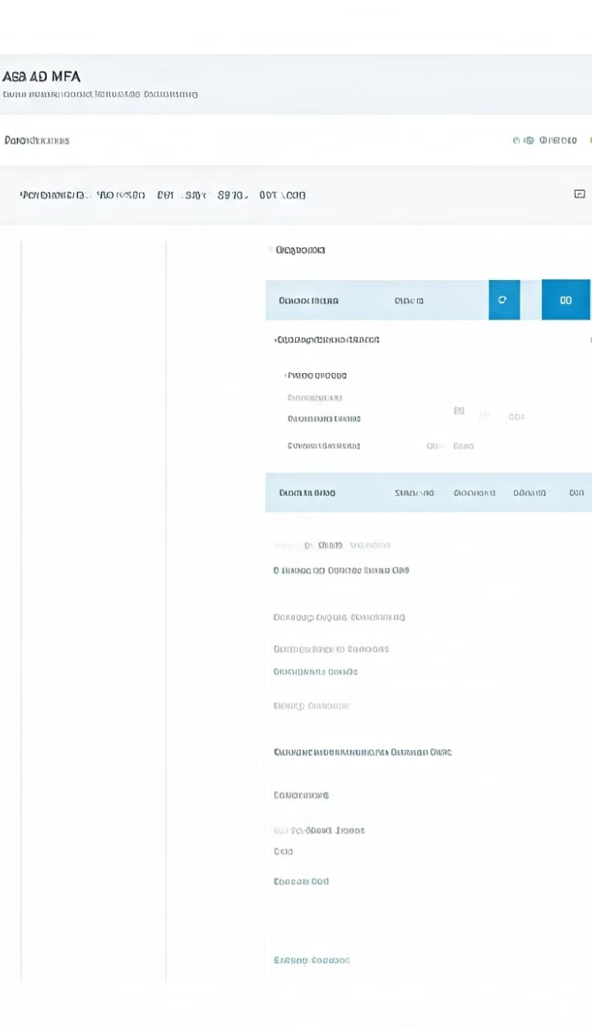
Generating Custom MFA Activity Reports
Report Type
Description
Key Metrics
MFA Usage Report
Provides an overview of MFA usage, including successful and failed authentication attempts, verification methods, and user details.
Successful/failed MFA attempts, verification method usage, user details
MFA Security Report
Highlights potential security risks, such as multiple failed attempts, unusual verification methods, and geographic anomalies.
High-risk events, unusual authentication patterns, geographic distribution
MFA Compliance Report
Tracks MFA registration and enforcement, ensuring that your organization's policies are being properly implemented.
MFA registration and enrollment, policy enforcement, compliance metrics
Customized Reports
Allows you to create tailored reports based on your specific business requirements and security needs.
Flexible, based on your organization's needs

Slide 9
Integrating MFA Data with Security Tools
Security Information and Event Management (SIEM)
Identity and Access Management (IAM)
Security Orchestration and Automated Response (SOAR)
Leverage MFA activity data to enhance your IAM processes, including user behavior analytics, risk-based access controls, and privileged access management.
Integrate Azure AD MFA activity data with your SIEM solution, such as Azure Sentinel or Splunk, to gain a comprehensive view of security events and enable advanced threat detection and incident response.
Integrate MFA activity data with your SOAR platform to automate incident response workflows, such as triggering remediation actions or generating custom alerts based on high-risk events.

Slide 10
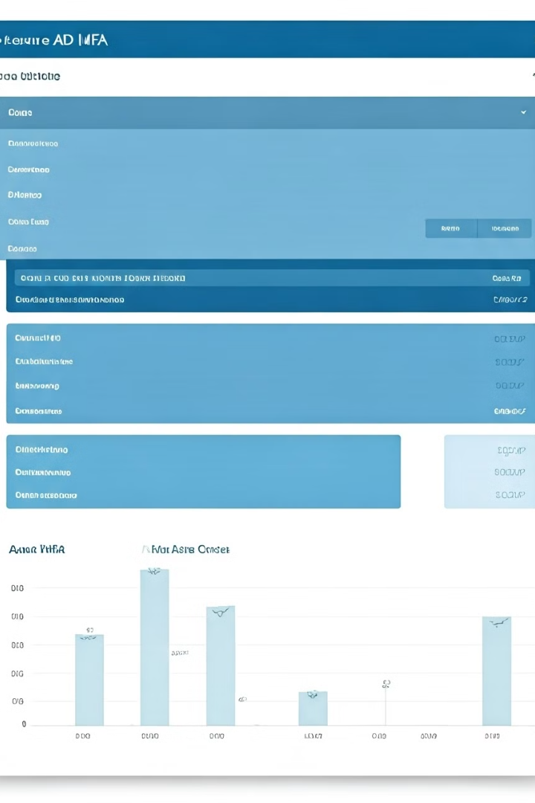
Best Practices for Monitoring Azure AD MFA
1
Establish Comprehensive Monitoring
Implement a holistic monitoring strategy that covers all aspects of Azure AD MFA, including activity logs, user registration, enforcement policies, and security events.
2
Leverage Analytics and Reporting
Utilize advanced analytics and reporting capabilities to gain deeper insights into MFA usage patterns, identify security risks, and measure the overall effectiveness of your MFA implementation.
3
Integrate with Security Ecosystem
Seamlessly integrate Azure AD MFA activity data with your broader security ecosystem, including SIEM, IAM, and SOAR tools, to enhance your security posture and streamline incident response.
4
Continuously Optimize and Improve
Regularly review and refine your Azure AD MFA monitoring and reporting strategies to address evolving security threats, user needs, and business requirements.

